Slide 1
Welcome to the
Financial Aid Basics
- OVERVIEW - An Orientation to Financial Aid
Financial Aid and Scholarships
2022-2023
Notes:
Hello and welcome to the Financial Aid and Scholarships presentation. We are very glad you are here to review some of the Financial Aid Basics.
The goal today is to review some of the basics related to the Financial Aid process, familiarize you with some of the terminology and to figure out your next steps for paying for college.

Slide 2
UNDERSTANDING Financial Aid
Notes:
Understanding the Language
Financial Aid can be challenging and overwhelming! So it’s important to understand some of the basic terminology and ACRONYMS as you begin your journey down the road to earning a degree.

Slide 3
FAFSA = Free Application for Federal Student Aid
1. Get Prepared
2. Complete FAFSA Form (renewed every year)
3. Review Student Aid Report
4. Respond to Aid Offer
5. Receive Aid
Notes:
Here is a general overview of the Financial Aid application process:
Get prepared by gathering the documents you will need to complete the FAFSA (e.g. SSN, driver’s license number, Federal tax information (use from 2 years prior) and information about cash, savings checking balances, investments and other assets for you and your parents if you are a dependent student.
Use taxes filed for 2020 for the 2022-23 school year. You may be able to use DRT to transfer your data from the IRS more quickly.
Be sure to keep these records as you may need them again later.
Complete FAFSA online at studentaid.gov, use the mobile app or complete on paper. This process is completed annually.
Review your Student Aid Report (SAR). This is a summary of the FAFSA data submitted. It is NOT the amount of financial aid you will receive. You should receive this within 3 days to 3 weeks after you submit the FAFSA. Review information carefully to ensure it is correct.
If you have been accepted to a college listed on your FAFSA, the school will calculate your aid and send you an electronic or paper aid offer sometimes referred to as an award letter.
Review aid types. Is it free money (grants, scholarships) or is it a loan that you will have to repay? Loans need to be accepted in order to be distributed to you.

Slide 4
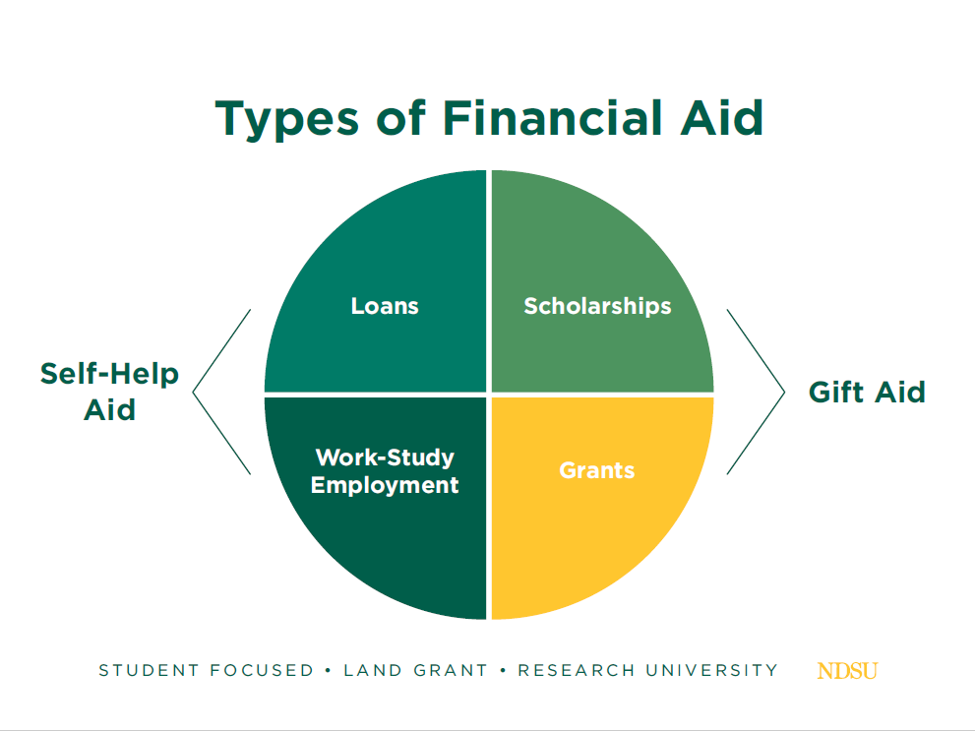
Notes:
Types of Financial Aid include:
Gift Aid such as grants or scholarships. These are resources that can help you pay for college that you do not have to repay.
Self-Help aid includes such things as loans and work-study employment. Loans of course must repaid; however, Work-Study is funding that you earn by working. The award helps to pay a percentage of the hourly wage and doesn’t count against you for the purposes of financial aid.

Slide 5
Who decides how much aid I may receive?
Cost of Attendance
COA includes: tuition, fees, housing, meals, books, supplies
EFC
Expected Family Contribution (EFC) (comes from information provided on the FAFSA)
Aid Eligibility
COA – EFC = AID ELIGIBILITY
Notes:
EFC is the number that Financial Aid uses to determine how much aid you can receive at their college
EFC is calculated by formula established by law
Includes taxed and untaxed income, assets and benefits
Includes family size
Includes number of family attending college
EFC is not the amount you pay
EFC determines aid eligibility
FAFSA provides source of data used to calculate EFC

Slide 6
What’s a Budget?
Budgets can vary by college!
Budgets provide an estimate of costs based on:
State of residence
Academic program
Number of enrolled credits (FT, HT, PT)
NOTE: A budget is not an exact amount you pay! It’s an estimate which is tied to the Cost of Attendance.
COA – FINANCIAL AID = LOAN ELIGIBILITY
Notes:
Cost of Attendance and Budget
Financial Aid and Scholarships annually creates an estimated “BUDGET” for students. The budget is an estimate based on the state of residence, the academic program selected, and, the number of credits a student takes. For the purposes of Financial Aid – 12 credits represents full time status and students must be enrolled in a minimum of 6 credits (half time) to be eligible to receive federal aid.
NOTE: A budget is not the exact amount of money you pay but rather it is an overall estimate of what it costs to attend the college and provides the foundation for determining financial aid and loan eligibility.
NOTE: Students who are enrolled less than half-time (less than 6 credits for undergraduate/professional students and less than 5 credits for graduate students) are not able to include room/board and miscellaneous expenses in their financial aid budget and are not eligible to receive federal direct loans or SEOG grant.

Slide 7
Big Picture
FAFSA
SAR
NET PRICE
Notes:
If you start to feel overwhelmed, it’s important to step back and remember
the BIG PICTURE:
FAFSA: Your application for Federal Aid
Includes: loans, grants, work study and some scholarships
SAR: Student Aid Report
The document you receive after completing the FAFSA
NET PRICE: It’s important to review the overall cost of attendance to know what
you will owe.

Slide 8
STUDENT AID REPORT
Student Aid Report: SAR
Summary of information provided on the FAFSA
Provides EFC, date FAFSA was received and date processed
Includes estimated eligibility for federal loans and grants
Review information - be sure it’s correct!
If no changes are needed – keep the SAR for your records
Notes:
Student Aid Report: SAR
A multi-page document that summarizes information provided on the FAFSA
Provides EFC, date FAFSA was received and date processed
Includes estimated eligibility for federal loans and grants
If you provide a valid e-mail address on the FAFSA, you will receive an e-mail with instructions on how to access the online copy of the SAR.
You should typically be able to access your SAR within 2 weeks of filing the FAFSA
Review information to be sure it’s correct!
Use checklist function in “WHAT YOU MUST DO NOW” section to make sure any issues are resolved.
If no changes are needed – keep the SAR for your records
SAR is also available by logging in to View your Student Aid Report

Slide 9
I found an error on my SAR. How do I correct it?
Make corrections at studentaid.gov
Select the “LOG IN” button and enter FSA ID
On the “My FAFSA” page, select “Make FAFSA Corrections.”
Create a save key.
Change your information
Submit the new information
Write corrections on paper SAR, sign it, and mail to address provided on the SAR ***This is not a preferred method
Notes:
When you fill out the FAFSA – it is possible to make mistakes and enter something incorrectly.
By going to FAFSA.GOV you can log using your FSA ID and on the “MY FAFSA” page, select “MAKE FAFSA CORRECTIONS”.
Next you create a SAVE key, update/correct the information and submit it for processing.
You can also write the corrections on the paper version of the SAR, sign it and mail it to the address listed on the document – but this is really not the preferred or most expedient way to take care of making corrections.

Slide 10
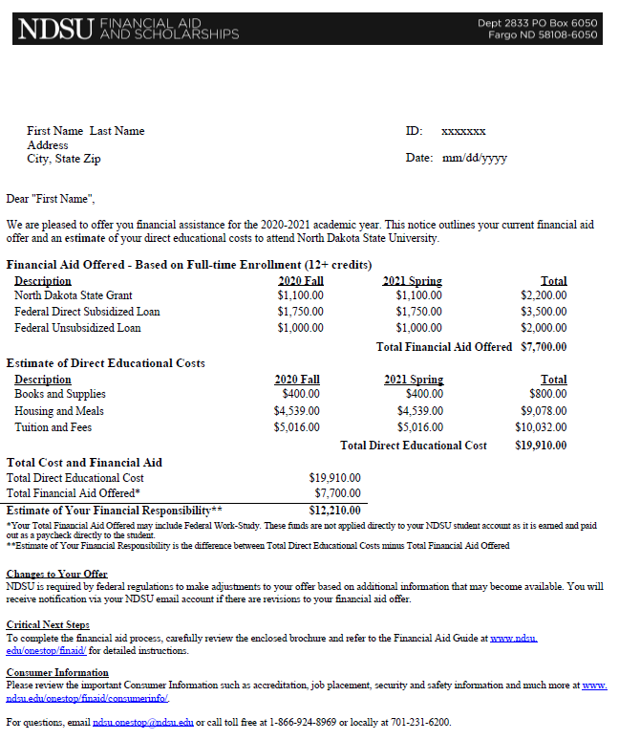
Financial Aid Award Offer
If you (student) completed a FAFSA, you can anticipate receiving an AWARD OFFER letter similar to this one.
At NDSU, the current information is also available to the student in Campus Connection
If you (student) did not complete a FAFSA, you can use the online link to locate the estimated cost of attendance.
EXAMPLE
https://www.ndsu.edu/onestop/finaid/cost/
Notes:
Here is an EXAMPLE of a Financial Aid Award Offer NDSU sends out.
If you completed the FAFSA for 2022-23, a document similar to what you see here will be mailed to you. A copy of the letter is available online in your Campus Connection.
Students can expect to receive an email from our office any time there is a change to their financial aid (for example … when a new scholarship is added to the award). New hard copy letters are not sent out; but, the updated awards offered can be viewed in Campus Connection.
If you did not complete a FAFSA, or did not receive this letter, you can also estimate overall costs from the Cost of Attendance and Budget page on the NDSU web site or simply monitor the student account balance in Campus Connection.
This is where you will also find the Budget Calculator Worksheet!

Slide 11
PLAN AHEAD … KNOW WHAT YOU OWE BEFORE YOU GO!
Notes:
Know what you will owe BEFORE you go!
This may seem simple, and it can be, but it can also be overwhelming.
Reading the information available to you and planning ahead will help you make the right decisions and be better prepared to enter college. It’s important to have a plan in place for paying the bill so you are not stressing about it and have limited time.

Slide 12
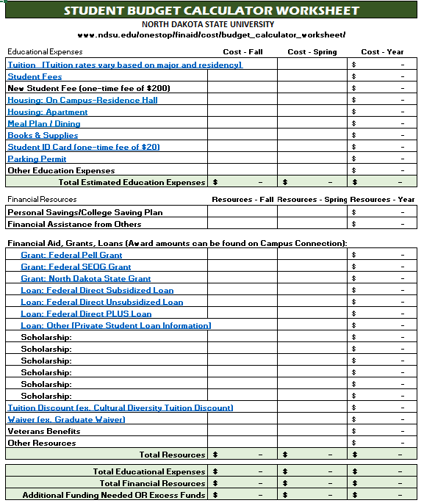
Estimate the Bill
Go to www.ndsu.edu search for: Budget Calculator Worksheet
x
Notes:
ESTIMATE THE BILL – WILL WE HAVE ENOUGH?
A good place to start when trying to determine if the student or family will need additional financial resources is by using a worksheet. It’s important to “Know what you’ll owe BEFORE you go!”
We have developed an interactive Budget Calculator Worksheet you can use to estimate the overall cost to attend NDSU. Use the Excel Version of this document (which is available on line) and you can simply enter your data into the spreadsheet and let the worksheet do the rest! To locate this document, you can use the link listed on this page or simply go to the NDSU home page and search for “Budget Calculator Worksheet”. This document is set up to make it easy to enter in your expenses and resources and help you automatically calculate if you will have an estimated balance due.
Begin by entering the estimated costs, financial aid offered, and any other resources such as scholarships, college savings plans and personal savings. Your payment due is the balance that remains AFTER the anticipated financial aid has been applied to the bill. Depending on your charges and financial aid offered, they may not owe anything to the college. At NDSU the actual charges are posted to Campus Connection Student Center – no hard copy bills will be sent to you.
Be as complete as possible so that you can determine the amount you will need! Please note there are different tuition rates charged depending on state of residence and there are also different rates listed for students majoring in certain programs (e.g. Architecture, Business, Engineering, Nursing and Pharmacy). Those specific majors have what is referred to as DIFFERENTIAL tuition. DIFFERENTIAL TUITION is assessed to students in selected programs to cover additional resources and facilities associated with those programs. It replaces the base rate.
You will note that there is not a spot for Work-Study in the Financial Resources section! This is because Work-Study awards are not disbursed to the student account and therefore funds DO NOT apply directly toward a student’s bill with NDSU. Work-Study is money that is earned by the student and it is paid twice per month in the form of a paycheck.
If the student completed a FAFSA and has received a financial aid offer letter, simply refer to that document and fill in any financial aid that has been offered. If you did not complete the FAFSA – I would encourage you to do so. Some scholarships and private loan lenders do require FAFSA completion.
You will also want to add any resources you have that are not listed on the Award Offer letter. If you have been awarded a scholarship that is not listed in the award offer letter, be sure to include that information and note whether it will be applied for fall or spring semester. Being as accurate as possible will give you a better idea of what your total expenses may be and whether or not you will need to seek additional assistance to pay the bill.

Slide 13
Student Employment
Finding and Securing a Job:
On Campus jobs available for all students
Find jobs on HANDSHAKE Job Board:
https://career-advising.ndsu.edu/
A Work-Study award is not required to work on campus!
Jobs help students earn money, gain job experience, and make important connections on Campus
Federal Work-Study (FWS) Employment:
Awards are not applied to the student’s account
Awards are earned and paid directly to the student in the form of a paycheck
Go to Campus Connection to Accept the FWS Award
Awards not accepted by October 1st are cancelled and offered to other eligible students
Contact NDSU One Stop to be added to the waiting list.
Notes:
Another option to help pay for college or cover personal expenses is through student employment. On Campus jobs are available to all students who want to work. Jobs are posted in HANDSHAKE available from the Career and Academic Advising Center website. Job opportunities are posted frequently so it’s important to check the web site often while looking for a job. These jobs not only help the student to earn extra money, they also help the student to gain valuable job experience and even make important connections on campus. Remember, students don’t have to have a Work-Study award to be working on campus.
A common misconception is that since Work-Study awards are listed as part of the student’s financial aid package, that the funds are placed directly to a student’s account balance. That is not true. While the award is considered part of the financial aid package, the funds are earned and paid directly to the student in the form of a paycheck. Work-Study funds help to pay a portion of the student’s hourly rate of pay. If the student receives a Work-Study award the student will need to accept that award in Campus Connection in order to make it available to be used. Awards not accepted by October 1 will be cancelled and offered to other eligible students. If a student did not receive a FWS award and would like to be considered for one, simply contact NDSU One Stop (701)231-6200 and request to be added to the waiting list.

Slide 14
PAYMENT OPTIONS / RESOURCES
Self Pay:
personal savings including money received from graduation and earnings from working during the summer
Parental assistance
Funds from college savings plan (e.g. 529 plan)
External scholarships
Loans:
Federal Direct loans (subsidized and unsubsidized)
Private Education loan
Parent PLUS loan
NDSU payment plan
Notes:
After completing the Budget Calculator Worksheet, you may find you will have a balance due after all of your financial resources have been applied.
So what do you do now? There are a few different options for covering this remaining amount. I will take a little time to go over each option so you know exactly what your next steps are once you have chosen the option that works best for you.
Today we will be taking a closer look at:
Self Pay (online, by mail or in person)
Payment Plan
Loans (Private or Direct PLUS loan)

Slide 15
Self Pay
Balances due at NDSU are posted online (Campus Connection)
NDSU does not mail billing statements to current students (statements and reminders are sent via email).
Pay bill:
Online (NDSU Campus Connection)
Mail in payment or make payment in person - NDSU One Stop
Pay balance due by published due date(s) to avoid late fees or registration holds.
Notes:
First is SELF PAY – or simply paying that remaining balance out of pocket. Your remaining balance due will be posted on your Campus Connection after financial aid has been applied to your student account. Please be aware that NDSU DOES NOT SEND YOU A BILL IN THE MAIL, so please be watching for that information online in your Campus Connection account. You can pay the balance due online through Campus Connection, send a check to NDSU Customer Account Services, or, drop off cash or check at the NDSU One Stop located in the NDSU Memorial Union.
Be sure to pay the balance that is due by the published due date(s) to avoid late fees or registration holds. The dates and deadlines are posted online.

Slide 16
Payment Plan
Monthly payment plan: Available only for Fall and Spring semesters
Must be registered for classes in order to participate in the Payment Plan
Remaining balance (after other aid is applied) is eligible for the payment plan
$30 fee and 3 installments paid per term
Fall Enrollment available approximately July 15, 2022
www.ndsu.edu/onestop/accounts/payments/paymentplan/
Notes:
The next option you might consider is a payment plan.
Payment plans are available during Fall and Spring semesters.
The student must be registered in order to participate in the payment plan.
Any remaining balance on the student account after other aid is applied is eligible for the payment plan.
NDSU’s Payment plans require you to pay an enrollment fee of $30 (which is charged to the student account after installments are set up). No Down Payment is required. However, it recommended to make a down payment of approximately 25% of the account balance. Down payments can be made online, via mail or in person. Any remaining balance for the term is divided into 3 equal installments.
Enrollment in the Fall Payment plan available approximately July 15th, 2022.
For more information about the payment plan option, go to web site listed on this slide or simply search for “payment plan” from the NDSU home page.

Slide 17
Private Loans
Lender is a bank or credit union – (non-federal)
Student and Parents can be the borrowers
Fixed and variable interest rates available
Credit worthiness is required (a co-signer may be needed for students)
Can borrow up to the cost of attendance minus other aid
Some banks may not require payments on loan principal while a student is enrolled
More information about private loans is available at:
www.ndsu.edu/onestop/finaid/loans/altloans/
Notes:
Finally we come to Private Education loans. There are a variety of educational loan options for families. We will start with PRIVATE loans. These are non-federal loans offered by banks or credit unions. There are loans for both the student as the borrower and for the parent as the borrower.
Private loans offer both fixed and variable interest loans. Students borrowing this type of loan typically will need a co-signer and credit worthiness is required. You can borrow up to the cost of attendance minus any other aid the student is receiving. These loans are interest bearing loans but like federal student loans -- most will not require payments on the principal of the loan while the student is enrolled at least half time.
Parents may also borrow this type of loan on behalf of the student. You must meet credit requirements and can borrow up to the cost of attendance minus any other aid. The major difference between the student and the parent Private loans is that with the private loan for the parent, repayment typically begins upon full disbursement of the loan. Excess funds after educational costs are paid may be disbursed to the student.
All approved private loan funds are disbursed to the student account in Campus Connection.

Slide 18
PROCESSING PRIVATE LOANS
APPLICATION
APPLY ONLINE
CERTIFICATION
LENDER PROCESSES REQUEST
DISTRIBUTION
FUNDS DISTRIBUTED TO STUDENT ACCOUNT
Notes:
Once you apply for a private education loan and have met the lender’s requirements, NDSU will be contacted to certify that your student is enrolled and is eligible to receive the amount you have requested. Once certification is completed, the loan will be disbursed to your student’s NDSU account. Please be aware that if you apply for a loan you will want to indicate the loan period in the application. You may request a loan for a specific semester or for a full year. It is your choice.

Slide 19
FASTChoice
A Private Student Loan Comparison Tool
NDSU / One Stop / Financial Aid & Scholarships / Loans / Private Student Loans
Notes:
So, how do you determine which lender to use?
NDSU has a loan comparison tool available online called FAST CHOICE. You can locate this tool by going to the NDSU Home page, search for NDSU Financial Aid and Scholarships. From the Financial Aid and Scholarships home page, select LOANS and then select PRIVATE STUDENT LOANS. From there, simply slide down the page until you see this icon. Then, click on the icon to enter into the FASTCHOICE online tool.

Slide 20
Quick Federal Loan Facts
LOAN TYPE | BORROWER TYPE | INTEREST RATE (FIXED) | LOAN FEES
Subsidized and Unsubsidized | Undergraduate | 3.73% | 1.057%
Direct PLUS | Only federal loan option for Parents | 5.28% | 4.228%
Benefits:
Low fixed interest rates (set annually by Congress)
Flexible repayment plans (6 mos. grace period)
Direct Plus Loan Grace Period: Parent is the borrower and repayment begins once the loan is fully disbursed. Parent may request deferment while student is enrolled at least half-time. Interest will accrue during periods of deferment.
Notes:
By completing and submitting the FAFSA, you are submitting an application to be considered for federal aid which includes SUBSIDIZED and UNSUBSIDIZED loans. These guaranteed federal loans offered to the student. Loans are in the student’s name, and do not require a co-signer. These two loans are similar (same interest rate, origination fees and grace period). The difference is that the subsidized loan is awarded to students who demonstrate “financial need” and it does not accrue interest while the student is enrolled. The unsubsidized loan is not based on “financial need” and interest does start to accrue upon disbursement.
First Year / Freshmen can receive up to a combined total of $5500 total of SUBSIDIZED and UNSUBSIDIZED loans.
Direct PLUS loans are available for parents to borrow on behalf of their dependent undergraduate student. This is the only federal loan available to parents. We will go in to further detail about the DIRECT PLUS loan in a few minutes. There are also private loan options available and we will talk about those in a few minutes as well.

Slide 21
Direct PLUS Loan
Parents borrow on behalf of their dependent undergrad student
Long-term, fixed interest rate loan (FAFSA completion required)
LOAN TYPE | INTEREST RATE | LOAN FEES
Direct PLUS Loan | 6.28% | 4.228
A parents’ PLUS Loan denial due to adverse credit history may result in additional Direct Loan eligibility for the student
Borrow up to cost of attendance minus other aid received
Repayment begins upon full disbursement of the loan
Deferment options available by contacting the loan servicer
www.ndsu.edu/onestop/finaid/loans/federalloans/
Notes:
In a previous slide, we mentioned a federal loan option for parents to borrow on behalf of their dependent, undergraduate student – the Federal Direct PLUS loan. This is the only federal loan offered to parents. This loan currently offers a fixed interest rate of 5.28% and includes an origination fee of 4.228%. Interest rates on federal student loans are set by federal law, not the U.S. Department of Education. In order to take out this type of loan, the student is required to have completed the FAFSA.
Similar to the other parent-loan options, if you/your parent(s) decide to use this one, be aware that repayment begins once this loan is fully disbursed. There may be payment deferment options available by contacting the loan servicer. The loan application can be found by searching parent loan on the NDSU website. Also be aware that additional COVID regulations may apply. Be sure to visit the website listed here for updated information.
One additional point: If your parent(s) apply for this loan and are denied due to adverse credit history, please contact us through NDSU One Stop because you, the student, may be eligible to be awarded additional Unsubsidized Loan funds.

Slide 22
Special Circumstances
Q: Has there been a significant change of income in the family?
(e.g. reduction of income or benefits, high medical expenses, death of a parent)
A: You can request to have your financial aid reviewed.
Complete FAFSA as normal using 2020 tax return information
Submit the 2022-23 Special Circumstance form and provide required documents
This process allows us to re-evaluate the student’s financial aid eligibility based on a more accurate picture of your current financial situation. This process does not guarantee that additional aid will be available.
www.ndsu.edu/onestop/finaid/other/specialcircumstance/
Notes:
When completing the FAFSA you used income reported on your taxes from two years prior. If you have experienced a financial setback that will result in reduced earnings you can complete a Special Circumstance Form. By completing this document we are able to re-evaluate your current situation and possibly make adjustments based on your current financial standing.
Some situations that might warrant the completion of this form are things such as:
Reduction in your income due to job loss or reduced hours
Divorce of the parent.
Death of a parent or spouse.
Other unexpected expenses such as those that would be incurred due to a natural disaster or high medical costs not covered by insurance.
If you are experiencing extenuating circumstances, you may want to consider completing the Special Circumstance form. The form is available on our Financial Aid website and the link to the form is also listed here on this slide. By completing the process and submitting supporting documentation, we will be able to re-evaluate your student’s financial aid eligibility based on a more accurate picture of your current financial situation.
Be aware that all students who submit a Special Circumstance form must go through the Verification process. This process can take several weeks to complete and there is no guarantee that you will be awarded additional financial aid by completing and submitting the document for review.

Slide 23
Cultural Diversity Tuition Waiver
Eligibility
Self identify from an underrepresented ethnic group
Demonstrate financial need
Submit FAFSA by March 15
Limited awards available
Submit waiver application by April 1 deadline
Award amounts vary between $2000 - $8000 annually
Notes:
Scholarships – FREE MONEY – LESS DEBT!
Complete the FAFSA! Some scholarships require it!
Do your research!
Keep a portfolio with your application information
You may be able to simplify the process and save time by revising previous applications
Look for scholarship donors from:
Financial Aid office or Admissions office (online/in person)
High School Counselor
Local businesses or organizations that may be affiliated with your educational field

Slide 24
Important Dates
June 14-30 Summer Orientation (register for classes)
August 22 Classes start
September 5 Financial Aid (loans, grants, scholarships) applied to student accounts
September 7 Payments are due
October 15 Late fees applied to balances due
www.ndsu.edu/registrar/dates/
Notes:
Important Dates!
It’s important to know:
Will there be a summer Orientation?
When do classes start?
When to register?
When is Financial Aid applied to student account balances (loans, grants, scholarships)?
When are payments due?
When to apply for additional loans if needed?
When do late fees apply?
You can find this, and other important dates/deadline information on the NDSU Registration and Records web site.

Slide 25
Next steps https://www.ndsu.edu/onestop/guide/
1. Respond to Financial Aid Offer - Campus Connection
Log in to Campus Connection to Claim Account
Review and follow up on any Holds and “To Do” List items
Review Financial Aid Offer and accept, decline or reduce award(s)
Report outside scholarships/awards Submit scholarship checks to One Stop for deposit
2. Complete Federal Loan process
Additional required steps (if accepting Federal Loans):
Complete Entrance Counseling and sign the Loan Agreement (Master Promissory Note) for loans
Complete Annual Student Loan Acknowledgement (signifies you understand your responsibility to repay your loan)
Notes:
Let’s review a few things to summarize:
You can refer to the check lists on this slide and the next one to help you make sure all important steps related to financial aid are completed.
It’s important to review the Financial Aid Offer that is available in Campus Connection.
Be sure to accept, reduce or decline loans and/or work study if offered.
When you accept a federal loan you will be prompted to complete Entrance Counseling, Loan Agreement (MPN) and the Annual Student Loan Acknowledgment. Again, be sure to complete ALL of these items or your federal loans will NOT disburse to your student account.
Report all scholarships and waivers not listed in the Award Offer and submit any checks you receive to NDSU OneStop so we can post those funds to your student account balance.

Slide 26
Next steps continued
3. Estimate the bill – amount due
Use the Budget Calculator Worksheet – will additional funds be needed?
4. Review options and resources
Self pay – Savings – Payment plan – Private loan
5. Enroll in direct deposit!
6. Complete FERPA Consent to Release Form (online)
IMPORTANT!
Financial Aid disbursement can be delayed!
Be sure to complete all TO DO LIST items and complete Verification process to avoid delays in disbursement.
Notes:
Next …
Estimate the bill. By using the Budget Calculator Worksheet to review your costs vs. resources you will be able to determine if your student will need additional funding to pay the bill.
Decide if you want to set up a payment plan with Customer Account Services or apply for private education loans if needed.
Set up Direct Deposit! It’s quick and easy and there are many benefits to using it. Direct Deposit is used to speed up the process of providing refunds to the student. It is also used by NDSU Payroll for processing student payroll for on-campus employment!
If the student wants their parents or other family member to be able to visit with us about any aspect of their financial aid, they will need to complete and submit the FERPA Consent to Release form.
You must complete any items listed in their TO DO list in Campus Connection.
If selected for verification, be sure that process is completed and any requested documents are submitted in a timely manner.
And don’t forget to to check your NDSU email account! It’s the official means of communication! This is where we send any updates or important information to students!
If all of these steps are complete your aid, both federal and any Private loans and scholarships, will disburse to your student account on September 7th. If there is aid in excess of the account balance, and you have set up direct deposit, a refund will be processed electronically and deposited to your account has specified. If you choose not to set up direct deposit that refund will be mailed to you.
If you expect there will be a balance due this is the time: Be prepared to pay the bill by using one of the following methods: self pay, payment plan, private loan, etc. If you choose to use the Payment Plan option, be sure you have made the appropriate arrangements so that this process will take care of the balance due. Having an outstanding balance without arranging a payment plan will result in a hold being placed on the student’s account that will stop them from adding or dropping classes, or, from registering for future semesters.

Slide 27
Online Resources & Reminders:
NDSU Financial Aid: ndsu.edu/onestop/finaid
E-mail: NDSU email (per University policy) is an official means of communication. This is our primary method of contacting students!
Verification: If selected for verification you must complete the process before financial aid can be disbursed.
Satisfactory Academic Progress (SAP): Important! Students who do not meet SAP can lose their federal aid.
https://www.ndsu.edu/onestop/finaid/sap/sap_policy/
Notes:
Additional Reminders:
NDSU E-mail: It is university policy that NDSU email is the official means of communication with our students. This is our primary method of contacting our students.
Satisfactory Academic Progress: To receive federal financial aid (federal loans, some scholarships and even some private loans), students must meet certain academic requirements called Standards of Satisfactory Academic Progress (SAP). SAP requirements apply to ALL students and ALL terms of attendance including summer. This topic is important for students to understand, because, they can lose their ability to receive federal aid if they don’t meet SAP requirements. To view the complete policy online, use the link posted on this slide.
Verification: If selected for verification the student must complete the process before financial aid can be disbursed. Be sure to contact us if you have questions about this process.
FERPA policy: The Family Education Rights and Privacy Act (FERPA) protects the privacy of student records. By completing the FERPA online, the student may provide their consent to NDSU to authorize release of education records and non-directory information to parents and/or guardians. Non-directory information includes academic and financial records, such as grades, GPA’s, account balances, financial aid awards, and records containing SSN or health/medical information. Without completing the FERPA agreement, parents no longer have access to their student’s academic or financial records. This form must be completed online. To locate the form, make note of the link listed on this slide.

Slide 28
Financial Aid Guide for New Students
www.ndsu.edu/onestop/guide/
Notes:
Be sure to review the Financial Aid Guide for New Students. Here you will find all the basic steps and instructions to follow regarding all your financial aid requirements.
The NDSU Financial Aid home page also has several informative links that you can use to more fully understand the financial aid process.

Slide 29
Federal Student Aid Information
UNDERSTAND AID
APPLY FOR AID
COMPLETE AID PROCESS
MANAGE LOANS
Notes:
STUDENTAID.GOV is a terrific online resource available to help you learn more about how financial aid works, the various types of aid, how to apply for federal aid (FAFSA), and how to manage federal loans. If you haven’t already used this resource before I encourage you to bookmark it and refer back to it often!
It’s at your fingertips … 24/7!
NOTE: When setting up an account – you use your FSA ID and password!

Slide 30
More questions about financial aid?
Submit questions via email to: ndsu.financialaid@ndsu.edu A Financial Aid team member will get back to you as soon as possible.
Notes:
Thank you for viewing our Financial Aid Basics presentation online today! The world of Financial Aid can be overwhelming. I hope you have found this information helpful. Feel free to use other online resources available through the NDSU home page – Financial Aid and Scholarships, Registration and Records, CareerLink, as well the federal aid web site - StudentAid.gov. This presentation will be available to you online through Orientation and Student Success, so feel free to use it to your best advantage.
If you have any specific questions after viewing this information, I ask that you please contact us directly via email at: ndsu.financialaid@ndsu.edu. We will be monitoring this email account during Orientation season and a counselor will respond directly to you regarding any questions you submit as soon as possible.
Thank you for considering North Dakota State University!

